Slide 1
Operators and Expressions
Abu Saleh Musa Miah(Abid)
Research Student, Centre for Research & Innovation (CRI Unit-1)
Signal Processing & Computational Neuroscience Laboratory.
Dept. of Computer Science and Engineering (CSE).
Universtiy of Rajshahi.

Slide 2
Datatype
All c compilers support five fundamental data typees these are as follows. Those are:-
Integer
Floating point
Character
Double
Void (valueless)
In C language
* '%d' is used for Integer.
* '%f' is used for floating point * '%c' is used for character type data.

Slide 3

Integer Type:The variable of integer type are used to represent the integer type data . Integer type require two bytes of 16 bits of internal storage. Its range is -32768 ro 32767.
Character type: Character set are the set of alphabets, letters and some special characters that are valid in C language. character can be defined as a character are usually stored in 8 bytes of internal storage. Its range is -128 to 127.
Example:
Alphabets:
Uppercase: A B C .................................... X Y Z
Lowercase: a b c ...................................... x y z
Digits:
0 1 2 3 4 5 6 8 9
Special Characters

Slide 4
Special Characters in C language
, | < | > | . | _ | ( | ) | ; | $ | : | % | [ | ] | # | ?
' | & | { | } | " | ^ | ! | * | / | | | - | \ | ~ | +
White space Characters:
blank space, new line, horizontal tab, carriage return and form feed
Floating Type: The variable of Floating type are used to represent the floating point type numbers.Integer type require 4 bytes of 32 bits of internal storage. Its range is -3.4 E+38 to 3.4
E-38.
Double Type: The variable of double types are also used to represent the real numbers. But its requirement is double to the floating type that is 8 bytes or 64bits its range is 1.7 E-308 to 1.7 E+308
Void type: The void types has no values . this is usually used to specify the type of functions. The type of a function is said to be void when it does not return any value to calling functions.
Difference between float and double:
Generally the size of float(Single precision float data type) is 4 bytes and that of double(Double precision float data type) is 8 bytes. Floating point variables has a precision of 6 digits whereas the the precision of double is 14 digits

Slide 5
Example- # include<stdio.h>
# include< conio.h>
Void main ( )
{
clrscr ( );
int i; //integer type size of I is 2 byte
char c; //character type size of c is 1 byte
float d; //Floating type size of d is 8 byte
printf ("Enter your number :');
scanf ("%d", & i) ;
printf ("Enter our character :");
scanf ("%c",&c);
printf ("Enter your floating number :");
Scanf ("%f"; & d);
printf ("you Entered %d %c %f",I, c,d);
getch ( );
}

Slide 6
ASCII code
Abbreviated from american standard code for information interchange is a character-encoding scheme. ASCII codes represent text in computers, communications equipment and other devices that use text.
Text information is made of lots of individual units of information called ascii characters
An ASCII character is often just a key stroke on the computer keyboard.
An ASCII character can be:
A lower case letter of the English alphabet.
An upper case letter of the English alphabet.
A single digit from zero to nine.
A single space.
A punctuation mark such as . or , or : or ; etc
A math symbol such as + or - or / or ( or ) or = etc
A special character such as # or $ or ^ or | etc

Slide 7
ASCII code
; write a program which reads your name from the keyboard and outputs a listh of ASCII code, which represent your name. Exam:ACCE-2012,11,CSE,APPE
Ans:
#include<stdio.h>
int main() { int i; char name[50]; printf(“Enter your name: “); gets(name); printf(“nCharactertASCII Code“);
for(i=0;name[i]!=”;i++) printf(“n%ctt%d”,name[i],name[i]);
return 0; }

Slide 8
What is constants
Constants in C refers to fixed value that do no t change during the execution of a program. the constant definitions come before the variable declarations.
-constant –identifier –constant.
There are 4 type of constant in C . they are
Integer constant
Floating constant
Character constant
String constant
Constants are data values that cannot be changed during the execution of a program.
There are two technique in C to define constants:
1. Using #define preprocessor.
2. Using const keyword

Slide 9
The Define Keyword
#define identifier value
Here The #define is a Preprocessor Following is the form to use
#define preprocessor used to define a constant:
Example:
Here LENGTH, WIDTH are identifier name or vaiable name. we can these variable as a constant by defining with #define keyword.
#include <stdio.h>
#define LENGTH 10
#define WIDTH 5
#define NEWLINE '\n'
int main()
{
int area;
area = LENGTH * WIDTH;
printf("value of area : %d", area);
printf("%c", NEWLINE);
return 0;
}

Slide 10
The constant Keyword
const type variable = value
The const is a Preprocessor Following is the form to use Const preprocessor used to define a constant:
Example:
;
Here LENGTH, WIDTH are identifier name or vaiable name. we can these variable as a constant by defining with const keyword
#include <stdio.h>
const int LENGTH = 10;
const int WIDTH = 5;
const char NEWLINE = '\n'
int main()
{
;
int area;
area = LENGTH * WIDTH;
printf("value of area : %d", area);
printf("%c", NEWLINE);
return 0;
}

Slide 11
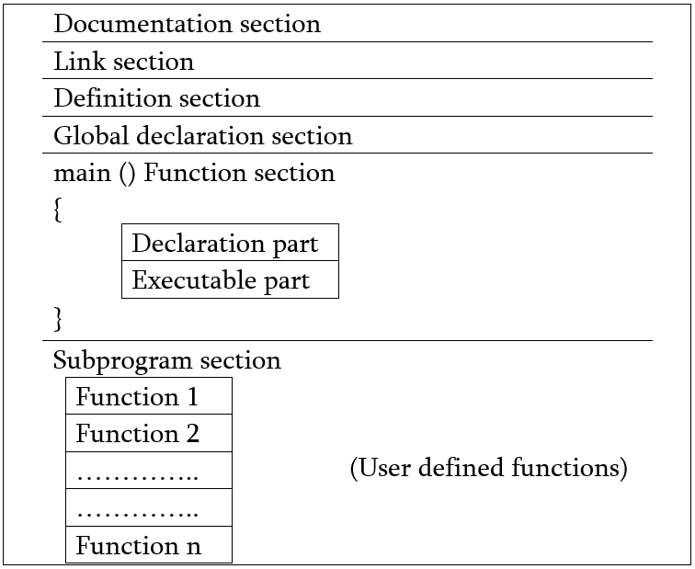
basic structure of c

Slide 12
Operator
Arithmetic expressions
Relational operators
Logical operators
Assignment operators
Increment and decrement operators
Conditional operators
Bitwies operators.
Special operator.

Slide 13
3.1 Introduction
An operator is a symbol that tells the computer to perform certain manipulations.
An expression is a sequence of operands and operators that reduces to a single value.
C operators can be classified into a number of categories.
Arithmetic operators
Relational operators
Logical operators
Assignment operators
Increment and decrement operators
Conditional operators
Bitwise operators
Special operators

Slide 14
3.2 Arithmetic operators
The arithmetic operators in C
Operator | meaning
+ | Addition or unary plus
- | Subtraction or unary minus
* | Multiplication
/ | Division
% | modulo division

Slide 15
3.2 Arithmetic operators
Note:,
Integer division truncates remainder
The % operator cannot be applied to a float or double.
The precedence of arithmetic operators
Unary + or -
* / %
+ -
Notes:
注意：
整数除法舍去余数；
%运算符只能用于整数
算术运算符的优先级

Slide 16
3.10 Arithmetic expressions
An arithmetic expression is a combination of variables, constants, and operators.
For example,
a*b-c → a*b-c
(m+n)(x+y) → (m+n)*(x+y)
ax²+bx+c → a*x*x+b*x+c

Slide 17
3.3 Relational Operators
The relational operators in C are :
Operator | Meaning
< | less that
<= | less than or equal to
> | greater than
>= | greater than or equal to
== | equal to
!= | not equal to

Slide 18
Relational Operators
A relational expression yields a value of 1 or 0.
5 < 6 1
-34 + 8 > 23 - 5 0
if a=3, b=2, c =1; then a > b > c is ?
the associativity of relational operators is left → right
Notes:
关系表达式的结果为1或0
注意计算关系表达式的值与判断关系表达式值的真假在表示上的差别
计算时，若关系成立，结果为1，否则结果为0；
判断关系表达式值的真假时，只要表达式的值为非0，就表示关系成立；为0则表示关系不成立。
经常采用简化写法，如n%2!=0可写为n%2
关系运算符的结合型：左-〉右

Slide 19
3.4 Logical operators
C has the following three logical operators
&& meaning logical and
|| meaning logical or
! meaning logical not ( unary operator )
Expressions connected by && or || are evaluated left to right, and evaluation stops as soon as the truth or falsehood of the result is known.

Slide 20
3.5 Assignment operators
The use of shorthand assignment operators has three advantages:
1. What appears on the left-hand side need not be repeated and therefore it becomes easier to write.
2. The statement is more concise and easier to read.
3. The statement is more efficient.
Notes:
使用复合的赋值运算符有三点好处：
容易书写
语句更简洁、易读
语句效率高

Slide 21
3.5 Assignment operators
a=a-3; Ans:a-=2;
a=a*2 Ans: a*=2;
a=a/4 Ans: a/=4;
a=a%2 Ans:a%=2;
b=b+(c+2) Ans: b+=c+2;
d=d*(n-5) Ans: d*=n-5;
Notes:
使用复合的赋值运算符有三点好处：
容易书写
语句更简洁、易读
语句效率高

Slide 22
3.6 Increment and decrement operators
C provides two unusual operators for incrementing and decrementing variables.
Increment operators (++):Increment operators are increase the value of subsequent. value may be increase according to the programmer.
Increment operator are two types as follows :
Post increment
Pre increment
Decrement operators ( -- )decrement operators decrease the value to one, two and so on.
As like Increment operators, decrement operators are also two type as :
Post decrement
Pre decrement
prefix operators (before the variable, : ++n),
or postfix operators (after the variable: n++).
Notes:
自增自减运算符
自增自减运算符“前置”和“后置”的区别
“前置” 变量先增值(或先减值),后被引用
“后置” 变量先被引用,后再增值(或后减值)
两种情况下，变量的值都加1

Slide 23
++X | X++
1.if the increment operator is fixed in a variabl. X a prefix (++x) on the right hand side of an assignment statement. | 1.If the increment operator is fixed in a variabbe. X as postfix (++x) on the right hand side of an assignment statement.
2.the compiler at first add one with the value of X and the result of adding in used in the statement. | 2. the compiler at first uses the value of x in th statement and add one with the valu in the nex execution.
X=5 Y=++XIn theis case value of Y and X are both | X=5Y=X++;In this case the value of Y is 5 and X is 6.
Notes:
自增自减运算符
自增自减运算符“前置”和“后置”的区别
“前置” 变量先增值(或先减值),后被引用
“后置” 变量先被引用,后再增值(或后减值)
两种情况下，变量的值都加1

Slide 24
The increment and decrement operators can be used in complex statements. Example:
m=n++ -j+10;
Consider the expression
m = - n++ ;
The precedence of ++ and – operators are the same as those of unary + and -.
The associatively of them is right to left.
m = - n++; is equivalent to m = - (n++)
Int amount,count;
Count=3;
Amount=2*++count;
Printf(“count=%d\n”,count,amount);
Notes:
++和—的优先级同单目的+，- 相同，右结合

Slide 25
if a=15 and b=10 what will be the value of c in the following expression?
Ans:
C=++a-b
C=b+++a;
int i=3,j=4,k=2;
i. i--;j++
(ii).k++*--i;
(iii) j+1/i+1
(iv) k+=k+i; j++
Notes:
++和—的优先级同单目的+，- 相同，右结合

Slide 26
3.7 Conditional operator
Conditional operators are used in decision making in C programming,
a ternary operator pair “? : ” is available in C to construct conditional expressions of the form
expr1 ? expr2 : expr3
the expression expr1 is evaluated first. If it is non-zero (true), then the expression expr2 is evaluated, and that is the value of the conditional expression. Otherwise expr3 is evaluated, and that is the value. Only one of expr2 and expr3 is evaluated.
Notes:
条件运算符是C语言中唯一的三目运算符

Slide 27
z = (a > b) ? a : b; /* z = max(a, b) */
Notes:
相当于
if ( a>b)
z=a;
else
z=b;

Slide 28
Type conversions in expressions
1. Implicit Type Conversion
Int a
Float=float( a)
This automatic conversion is known as implicit type conversion.
The rule of type conversion: the lower type is automatically converted to the higher type.
Notes:
类型的隐式转换：如果一个表达使用有多种类型，C自动由低类型向高类型转换

Slide 29
3.15 Operator precedence and Associativity
Rules of Precedence and Associativity
(1)Precedence rules decides the order in which different operators are applied.
(2)Associativity rule decide the order in which multiple occurrences of the same level operator are applied.
Table3.8 on page71 shows the summary of C Operators.
for example, a = i +1== j || k and 3 != x
Notes:
优先级和结合性的应用：
优先级决定了同一表达式中不同操作符的运算次序；
结合性决定表达式中同一优先级操作符的运算次序

Slide 30
Write a flowchart for find largest number from 2 number?
#include <stdio.h>
main()
{
int i,j,big;
scanf("%d%d",&i,&j);
);
if(i > j)
{
printf("biggest of two numbers is %d \n",i);
}
else
{
printf("biggest of two numbers is %d \n",j);
}
}
start
a,b
a>b
a,
,b
End
Notes:
优先级和结合性的应用：
优先级决定了同一表达式中不同操作符的运算次序；
结合性决定表达式中同一优先级操作符的运算次序

Slide 31
THANKS

